Slide 1
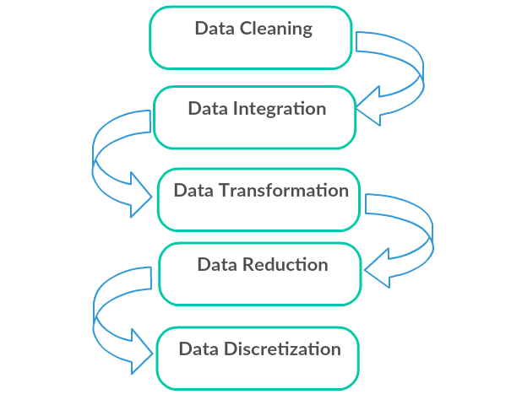
3. Data Preprocessing
Need Data pre-processing
Attributes and Data types
Statistical descriptions of Data
Handling missing Data
Data sampling
Data cleaning
Data Integration and transformation
Data reduction
Discretization and generating concept hierarchies

Slide 2
Data preprocessing for quality mining
No quality data, no quality mining results!
Quality decisions must be based on quality data
Duplicate or missing data may cause incorrect or even misleading statistics.
Data warehouse needs consistent integration of quality data
Data extraction, cleaning, and transformation comprises the majority of the work of building a data warehouse

Slide 3
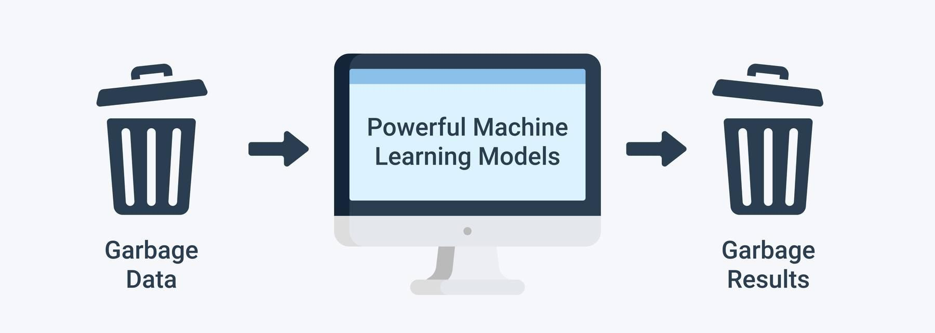

Slide 4
why data cleaning ?
Data in the real world is dirty
Incomplete: lacking attribute values, lacking certain attributes of interest, or containing only aggregate data
e.g., occupation=“ ”
Noisy: containing errors or outliers
e.g., Salary=“-10”
Outliers are very different from normal data
e,g, Salary =10000000
Inconsistent: containing discrepancies in codes or names
e.g., Age=“42” Birthday=“03/07/1997”
e.g., Was rating “1,2,3”, now rating “A, B, C”
e.g., discrepancy between duplicate records

Slide 5
why data cleaning ?
Incomplete data may come from
“Not applicable” data value when collected
Different considerations between the time when the data was collected and when it is analyzed
Human/hardware/software problems
Noisy data (incorrect values) may come from
Faulty data collection instruments
Human or computer error at data entry
Errors in data transmission

Slide 6
why data cleaning ?
Inconsistent data may come from
Different data sources
Functional dependency violation (e.g., modify some linked data)
Duplicate records also need data cleaning

Slide 7
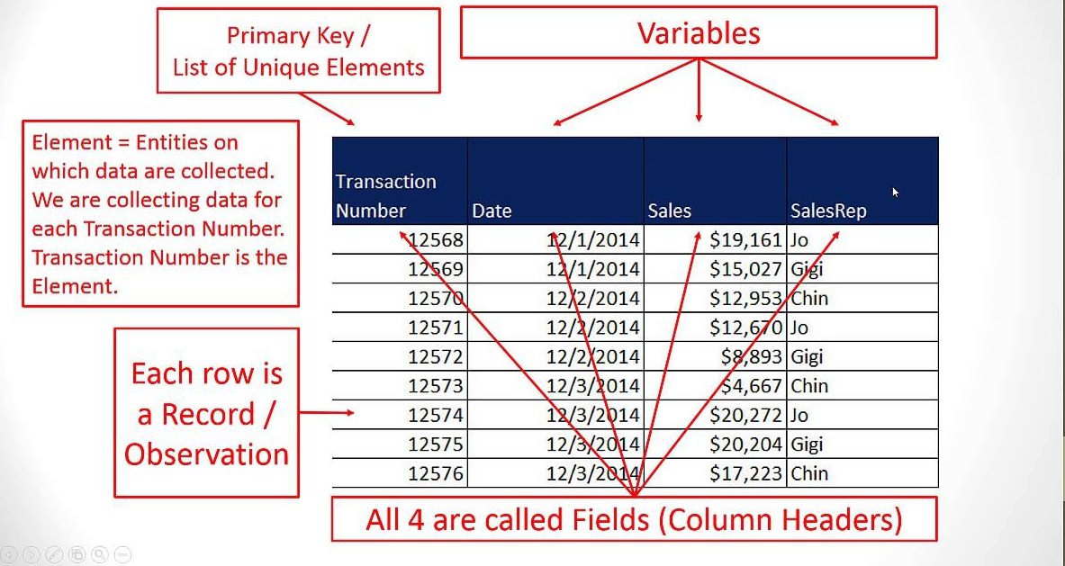
Attributes and Data types :Data sets
Data sets are made up of data objects or entities usually represented in the form of a table/matrix or a set of tuples.
Each row of the table represents an entity while column represents an attribute.
Attribute Type can be
Binary
Numeric
Ordinal/nominal

Slide 8
Types of data
Binary Variable - Binary variable has only two states : 0 or 1, where 0 means that the variable is absent and 1 means it is present.
A binary attribute is Symmetric if both states are equally valuable. A binary attribute is Asymmetric if both states are not equally important. Convention is to code important outcome as 1 and the other as 0.
Nominal attribute values are names, Each value representing some category. The values are enumerations without any meaningful order
Ex. Color, Nationality,Name etc.

Slide 9
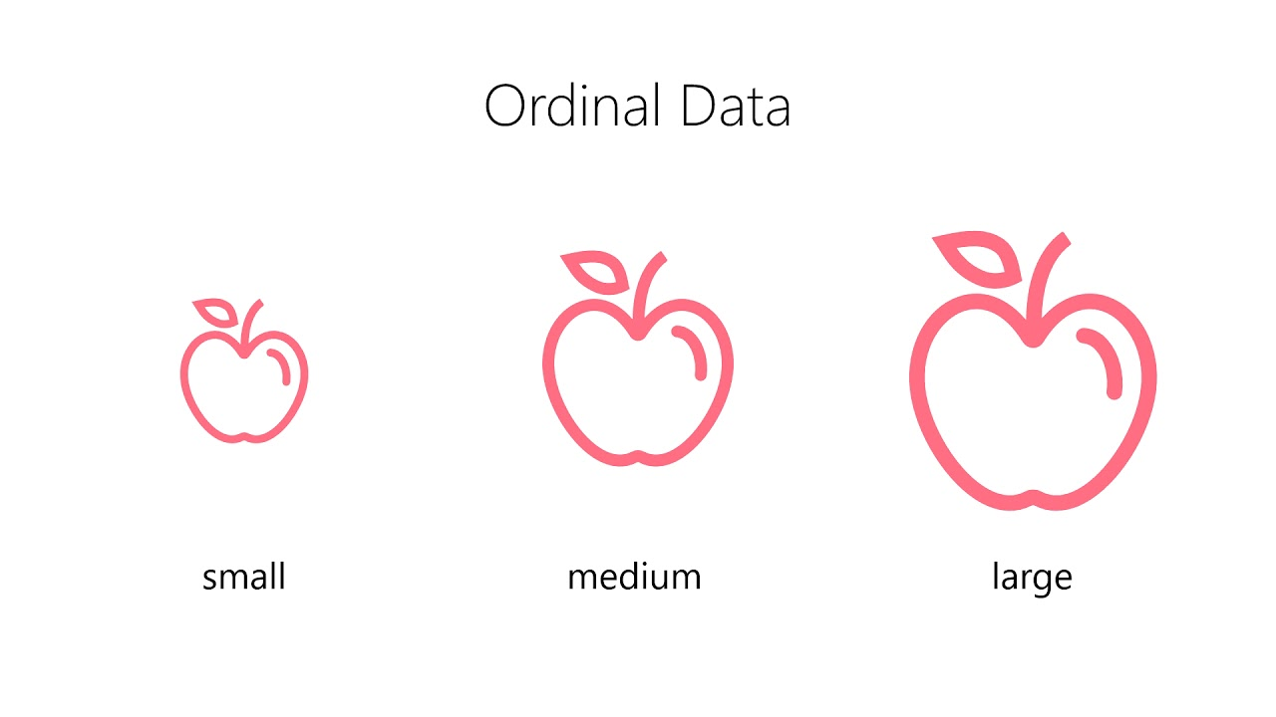
Types of data
Ordinal Attributes have a meaningful order or ranking about them
Numeric attributes – These are measurable or quantitative attributes
A discrete attribute has finite or countably infinite set of values, Otherwise the attribute is continuous

Slide 10
Statistical description of data
For data preprocessing to be successful, it is essential to have an overall picture of your data.
Basic statistical descriptions can be used to identify properties of the data and highlight which data values should be treated as noise or outliers.
We can describe data by :
Measures of central tendency :understanding the distribution of data
Measures of dispersion of data :understanding the variations of data
Graphical displays or plots : visualizing data summaries

Slide 11
Measures of central tendency
Mean
Centre of data set, can be obtained using a built in aggregation function avg in SQL
can be computed using some algebraic function on one or more distributive measures mean() = sum() /count()
It is a distributive measure – can be computed parallely on partitions
It is extremely sensitive – Even a small amount of extreme values can corrupt the mean
Trimmed mean can be obtained by chopping extreme values
It is ideal for symmetric data

Slide 12
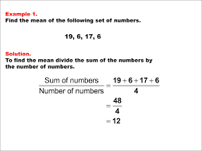

Slide 13
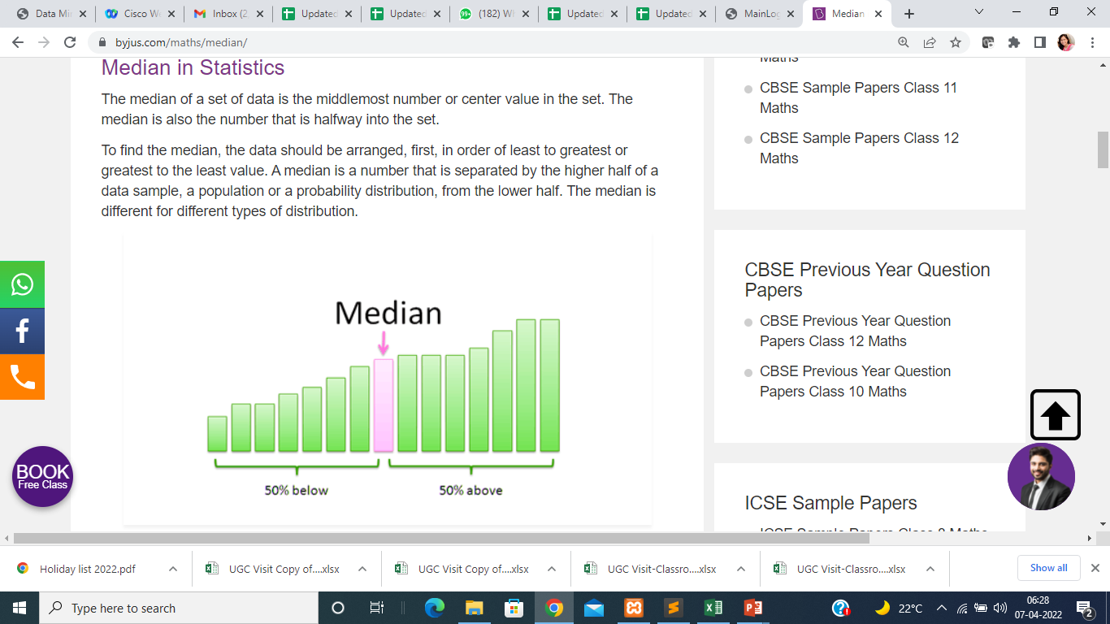
Measures of central tendency
Median
Center of data set, It is the middle value of the ordered set(if n is odd) or average of two middle values(if n is even)
It need to be computed on the entire data set as a whole
It is not a distributive measure- It cannot be computed by partitioning the data and parallely computing on each partition
It is computationally expensive – sorting entire data
It is less sensitive to extreme values
Ex. (Even number of values ) : The median of 3, 3, 5, 9, 11 is 5. If there is an even number of observations, then there is no single middle value; the median is then usually defined to be the mean of the two middle values: so the median of 3, 5, 7, 9 is (5+7)/2 = 6.

Slide 14
Measures of central tendency
Mode
The mode is the value that appears most frequently in a data set.
Ex. 3, 3, 6, 9, 16, 16, 16, 27, 27, 37, 48
Mode for above data is 16
We can have more than one mode in data. Ex. 3, 3, 3, 9, 16, 16, 16, 27, 37, 48
Data sets can be unimodal, bimodal , trimodal etc, Multimodal data sets have two or more modes
The mode is not affected by extreme values.

Slide 15
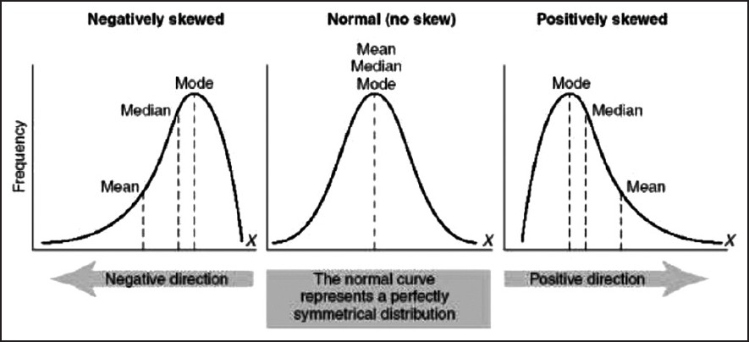
mean, median, and mode of symmetric versus positively and negatively skewed data.

Slide 16
Midrange
The midrange of the data set is simply the value between the biggest value and the lowest value.
Formula : Midrange = (Maximum Value + Minimum Value) / 2
It is easy to compute Max and min aggregate functions in SQL

Slide 17
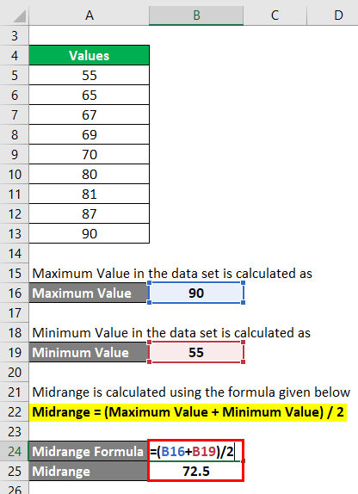

Slide 18
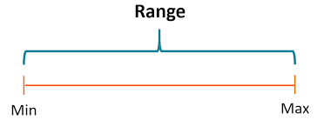
Measures of dispersion of data
Range
Let x1,x2,...,xN be a set of observations for some numeric attribute, X. The range of the set is the difference between the largest (max()) and smallest (min()) values
Example 1: Find the range of given observations: 32, 41, 28, 54, 35, 26, 23, 33, 38, 40.
Solution: Sort data in ascending order
23, 26, 28, 32, 33, 35, 38, 40, 41, 54
Since, 23 is the lowest value and 54 is the highest value, therefore, the range of the observations will be;
Range (X) = Max (X) – Min (X)
= 54 – 23
= 31

Slide 19
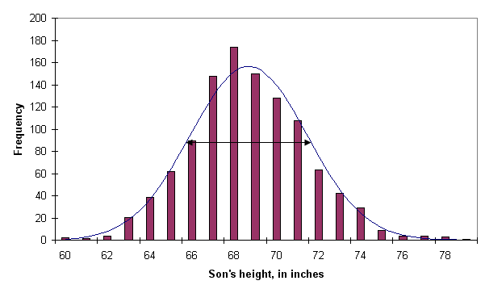
Measures of dispersion of data
Quantile
Quatiles are points taken at regular intervals of a data distribution, dividing it into essentially equal size consecutive sets.
The kth q-quantile for a given data distribution is the value x such that at most k/q of the data values are less than x and at most (q − k)/q of the data values are more than x, where k is an integer such that 0 < k < q. There are q − 1 q-quantiles
Quan1
Quan2
Quan 3
Quan 4

Slide 20
Measures of dispersion of data
Example
Thus 64 is the value of X such that 1/5 of the observations is less than the value of 64 and 5-1/5 of the observations is greater
The 2-quantile is the data point dividing the lower and upper halves of the data distribution.
The 4-quantiles are the three data points that split the data distribution into four equal parts; each part represents one-fourth of the data distribution. They are more commonly referred to as quartiles.
Quan1
Quan2
Quan 3
Quan 4

Slide 21
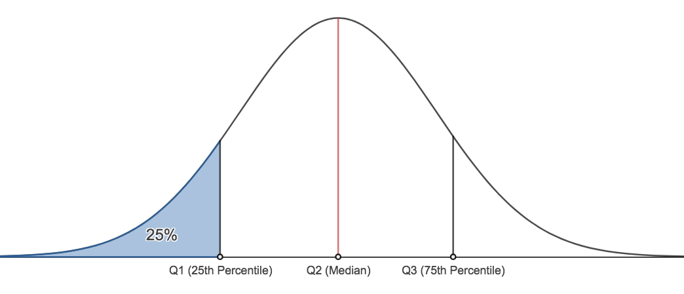
Measures of dispersion of data
Percentile
The kth percentile of a data set is the value x with property that k percent values are below x. Median is 50th percentile.
A plot of the data distribution for some attribute X. The quantiles plotted are quartiles. The three quartiles divide the distribution into four equal-size consecutive subsets. The second quartile corresponds to the median.

Slide 22
Measures of dispersion of data
Interquartile Range
The distance between the first and third quartiles is a simple measure of spread that gives the range covered by the middle half of the data. This distance is called the interquartile range (IQR) and is defined as
Ex. Q1=65, Q2=68, Q3=72
IQR = Q3-Q1 = 72-65 = 7
Quan1
Quan2
Quan 3

Slide 23
Measures of dispersion of data
Five number Summery
No single numeric measure of spread (e.g., IQR) is very useful for describing skewed distributions.
The five-number summary of a distribution consists of the median (Q2), the quartiles Q1 and Q3, and the smallest and largest individual observations, written in the order of Minimum, Q1, Median, Q3, Maximum.
Min
Quan1
Quan2
Quan 3
Max

Slide 24
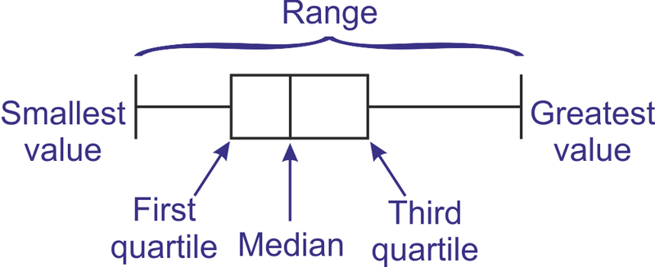
Graphical displays
Boxplots
Boxplots are a popular way of visualizing a distribution.
the ends of the box are at the quartiles so that the box length is the interquartile range.
The median is marked by a line within the box.
Two lines (called whiskers) outside the box extend to the smallest (Minimum) and largest (Maximum) observations.

Slide 25
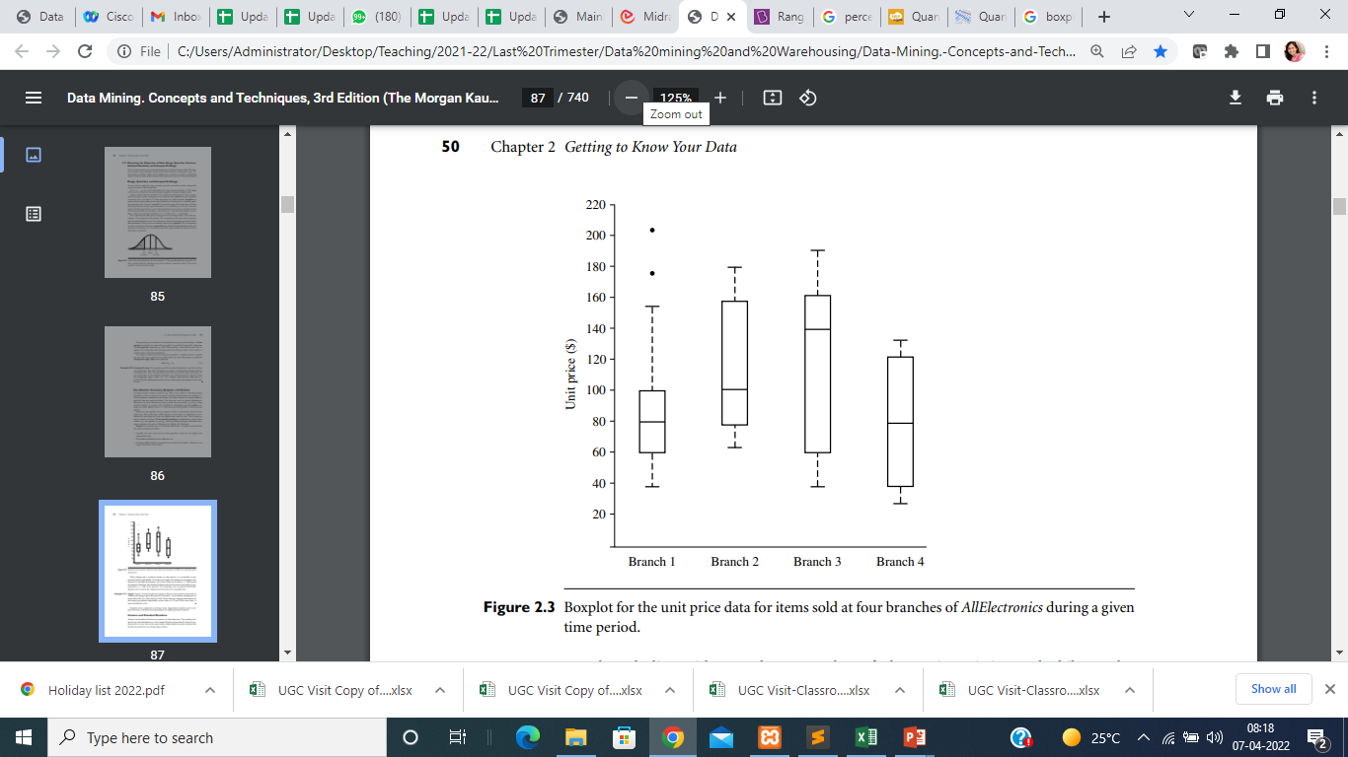

Slide 26
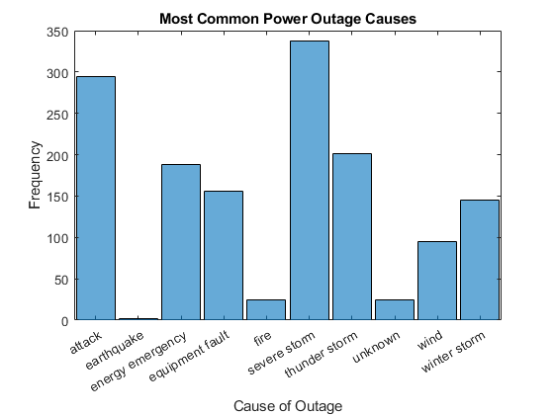
Graphical displays
Histograms
Plotting histograms is a graphical method for summarizing the distribution of a given attribute, X
. If X is nominal, such as automobile model or item type, then a pole or vertical bar is drawn for each known value of X.
The height of the bar indicates the frequency (i.e., count) of that X value.

Slide 27
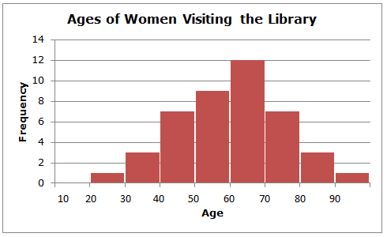
Graphical displays
Histograms
If X is numeric, the term histogram is preferred.
The range of values for X is partitioned into disjoint consecutive subranges(buckets/bins)
The range of a bucket is known as the width.
For each subrange, a bar is drawn with a height that represents the total count of items observed within the subrange.

Slide 28
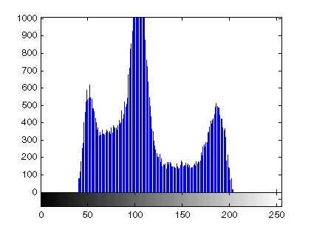
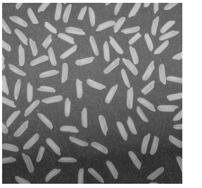
example : histogram for an image
histogram can be plotted by creating n equally spaced bins, each representing a range of data values.
Then plot the number of pixels within each range.
Image
Histogram

Slide 29
Data Cleaning
Data cleaning (or data cleansing) routines attempt to fill in missing values, smooth out noise while identifying outliers, and correct inconsistencies in the data.
Missing Values
Ignore the tuple
Fill in the missing values manually
Use a global constant to fill in the missing values
Use a measure of central tendency for the attribute to fill in the missing value
Use the attribute mean or median for all samples belonging to the same class as the given tuple

Slide 30
Handling of Noisy Data
1. Binning
Binning methods smooth a sorted data value by consulting its “neighborhood,” that is, the values around it.
first sort data and partition into (equal-frequency) bins
then one can smooth by bin means, smooth by bin median, smooth by bin boundaries, etc

Slide 31
Sorted data for price (in dollars): 4, 8, 9, 15, 21, 21, 24, 25, 26, 28, 29, 34
* Partition into equal-frequency bins:
- Bin 1: 4, 8, 9, 15
- Bin 2: 21, 21, 24, 25
- Bin 3: 26, 28, 29, 34
Smoothing by bin means: each bin value is replaced by the bin mean
- Bin 1: 9, 9, 9, 9 (mean for bin 1 is 9)
- Bin 2: 23, 23, 23, 23 (mean for bin 2 is 23)
- Bin 3: 29, 29, 29, 29 (mean fir bin 3 is 29)

Slide 32
Partition into equal-frequency bins:
- Bin 1: 4, 8, 9, 15
- Bin 2: 21, 21, 24, 25
- Bin 3: 26, 28, 29, 34
Smoothing by bin boundaries: minimum and maximum values in a given bin are identified as the bin boundaries. Each bin value is then replaced by the closest boundary value.
- Bin 1: 4, 4, 4, 15 ( boundary values for bin 1 are 4 and 15)
- Bin 2: 21, 21, 25, 25 ( boundary values for bin 2 are 21 and 25
- Bin 3: 26, 26, 26, 34 ( boundary values for bin 3 are 26 and 34)

Slide 33
Handling of Noisy Data
2. Regression
conforms data values to a function.
Linear regression involves finding the “best” line to fit two attributes (or variables) so that one attribute can be used to predict the other.
Multiple linear regression is an extension of linear regression, where more than two attributes are involved and the data are fit to a multidimensional surface.

Slide 34
Y1
smooth data by fitting the data into regression functions
Y1’
y = x + 1
X1
x

Slide 35
Handling of Noisy Data
3. Clustering
Outliers may be detected by clustering
for example, where similar values are organized into groups, or “clusters.” Intuitively, values that fall outside of the set of clusters may be considered outliers

Slide 36
Noise in data/Outliers

Slide 37
Data Cleaning Process
Data cleaning is a two steps process
1. discrepancy detection
2. discrepancy correction/transformation
1. discrepancy detection
Use metadata to discover data type and domain of each attribute, acceptable
values for each attribute ,mean, median, mode etc. Metadata can help to find noise, outliers, and unusual values that need investigation.
Data should be examined against unique rules, consecutive rules, and null rules.
A unique rule says that each value of the given attribute must be different from all other values for that attribute
A consecutive rule says that there can be no missing values between the lowest and highest values for the attribute, and that all values must also be unique.

Slide 38
A null rule specifies the use of blanks, question marks, special characters, or other strings that may indicate the null condition(e.g., where a value for a given attribute is not available), and how such values should be handled.
The null rule should specify how to record the null condition
Use of commercial tool for discrepancy detection.
2. discrepancy correction/transformation
ETL (extraction/transformation/loading) tools allow users to specify transforms
through a graphical user interface (GUI).

Slide 39
Data Integration
Combines data from multiple sources into a coherent store
Match schema and objects from different sources
Identify correlated attributes
Detection and resolution of data value conflicts
Databases
Data Warehouses
Flat files

Slide 40
Data Integration
1.Entity Identification problem
2. Redundancy and Correlation Analysis
3. Tuple Duplication
4. Data Value Conflict Detection and Resolution

Slide 41
1.Entity Identification problem
Map equivalent entities from multiple data sources
There can be name conflict, type conflict, attribute value conflict
Ex.student_name in one database and sname in another database
Different representations different scales
Ex. CGPA vs Percentage
Different range of values
EX. Grade values A,B,C in one and O,A,B,C,D on other
Percentage is calculated for all subjects in one whereas optional subjects are excluded in other for percentage calculations

Slide 42
Functional dependencies and referential constraints in the source system must match those in target system.
Ex. For example, in one system, a discount may be applied to the order,
whereas in another system it is applied to each individual line item within the order

Slide 43
2.Redundancy and correlation analysis
An attribute may be redundant if it can be derived from another attribute
Correlation analysis can be used to identify redundancies in the data, Given two attributes, such analysis can measure how strongly one attribute implies the other, based on the available data.
If two attributes are highly correlated and one attribute can determine the other.so one of these attribute can be dropped to avoid redundancy

Slide 44
3. Tuple Duplication
two or more identical tuples for a given unique data entry case
The use of denormalized tables is another source of data redundancy
Inconsistencies often arise between various duplicates, due to inaccurate data entry or updating some but not all data occurrences.

Slide 45
4.Data Value Conflict Detection and Resolution
for the same real-world entity, attribute values from different sources may differ, due to differences in representation, scaling, or encoding
Ex. 1. Salary for a person in one database is measured in RS. Whereas is other database it is in dollars
2. For a hotel chain, the price of rooms in different cities may involve
not only different currencies but also different services (e.g., free breakfast) and taxes

Slide 46
Attributes may also differ on the abstraction level, where an attribute in one system is recorded at, say, a lower abstraction level than the “same” attribute in another
Ex. the total sales in one database may refer to one branch of All Electronics, while an attribute of the same name in another database may refer to the total sales for All Electronics stores in a given region

Slide 47
Data transformation
the data are transformed or consolidated into forms appropriate for data modeling

Slide 48
Data Transformation Strategies
Smoothing – It removes noise from data- form of data cleaning-Techniques include binning, regression and clustering
Aggregation- Summary or aggregation operations are applied to data- Data cubes are constructed at multiple granularities.
Ex monthly sales , annual sales ,total number of admitted students
Generalization – low level raw data is replaced by higher level concepts
Ex. numerical attribute age mapped to higher level concepts like youth, middle-aged, and senior

Slide 49
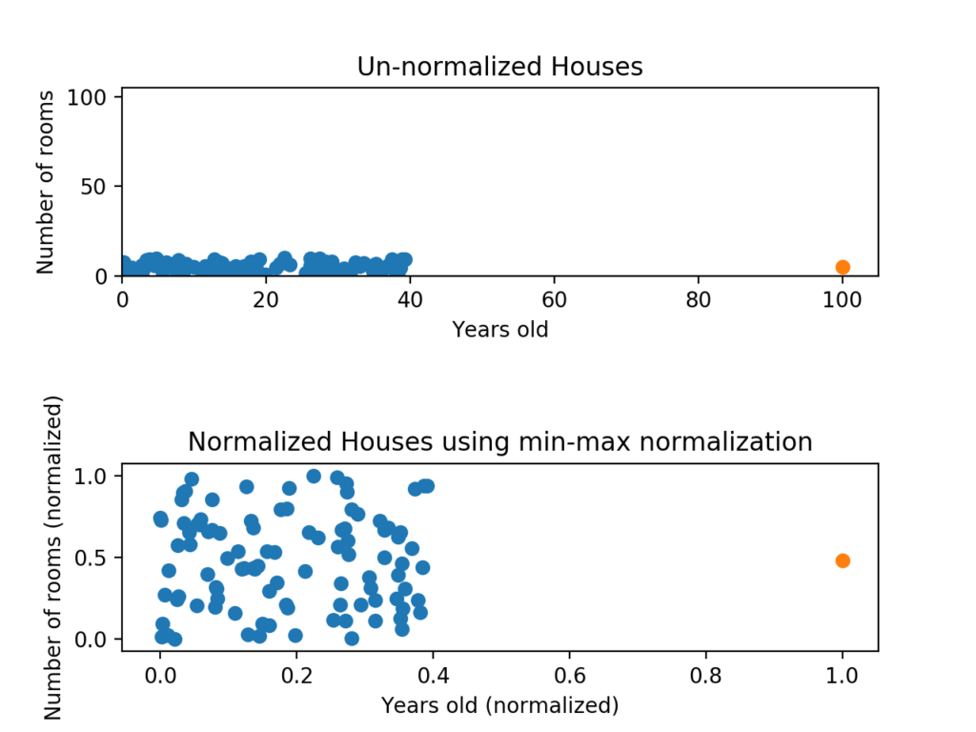
Normalization : where the attribute data are scaled so as to fall within a smaller range, such as −1.0 to 1.0, or 0.0 to 1.0.

Slide 50
Attribute Construction- (feature)New attributes are constructed and added from the given set of attributes.
Attributes with little predictive power can be combined with other attributes to form new attributes with high degree of predictive capability
The attributes price and earnings have some predictive value but ratio of price to earnings is better
Ex.
Create a new attribute as ratio of two current attributes
Create a new attribute as difference of two current attributes
Create a new attribute as percent increase or percent decrease of two current attributes

Slide 51
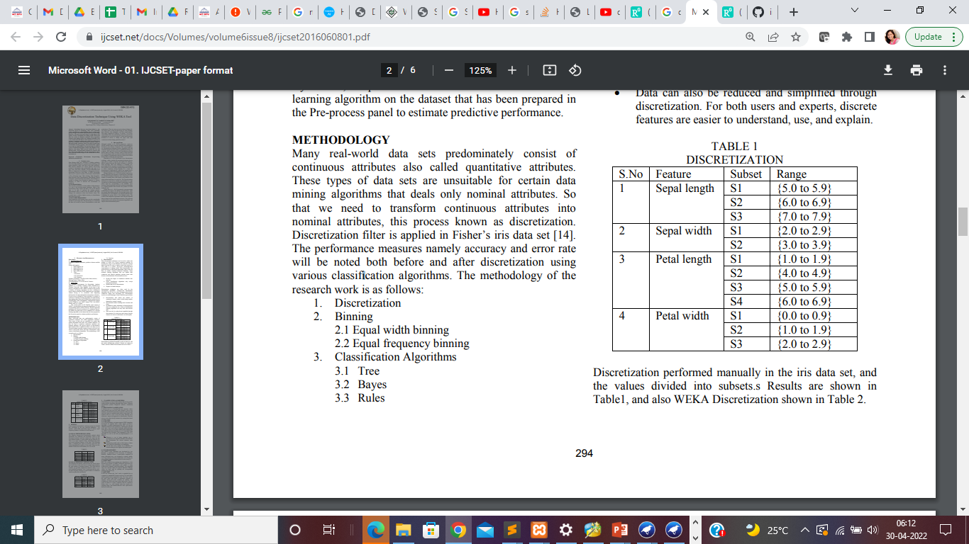
Discretization :
Data discretization techniques can be used to reduce the number of values for a given continuous attribute by dividing the range of the attribute into intervals.
Interval labels can then be used to replace actual data values
Example : Discretization of iris data set can give below output
Interval Labels

Slide 52
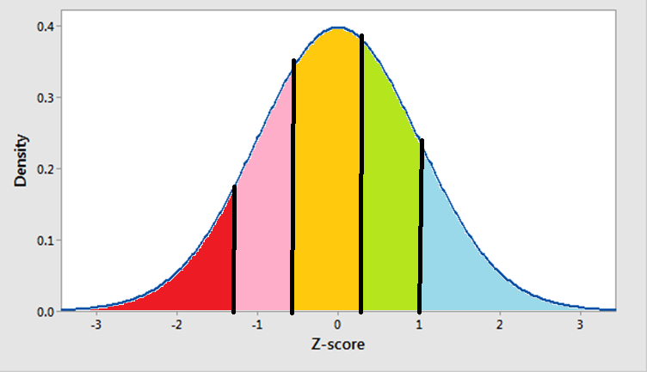
……………………………………
Class label n
Class label 1
Class label 2

Slide 53
Discretization Techniques :
Discretization by Binning : Attribute values can be discretized by applying equal-width or equal-frequency binning, and then replacing each bin value by the bin mean or median will lead to discretization of data.
Ex. Sorted data for price (in dollars): 4, 8, 9, 15, 21, 21, 24, 25, 26, 28, 29, 34
Smoothing by bin means for above data will be discretized into three values 9,23,29
- Bin 1: 9, 9, 9, 9
- Bin 2: 23, 23, 23, 23
- Bin 3: 29, 29, 29, 29

Slide 54
Discretization Techniques :
2. Discretization by Histogram Analysis
Discretization can be performed by Histogram analysis as histograms divide data into buckets
Interval label 1
Interval label 2
Interval label 8

Slide 55
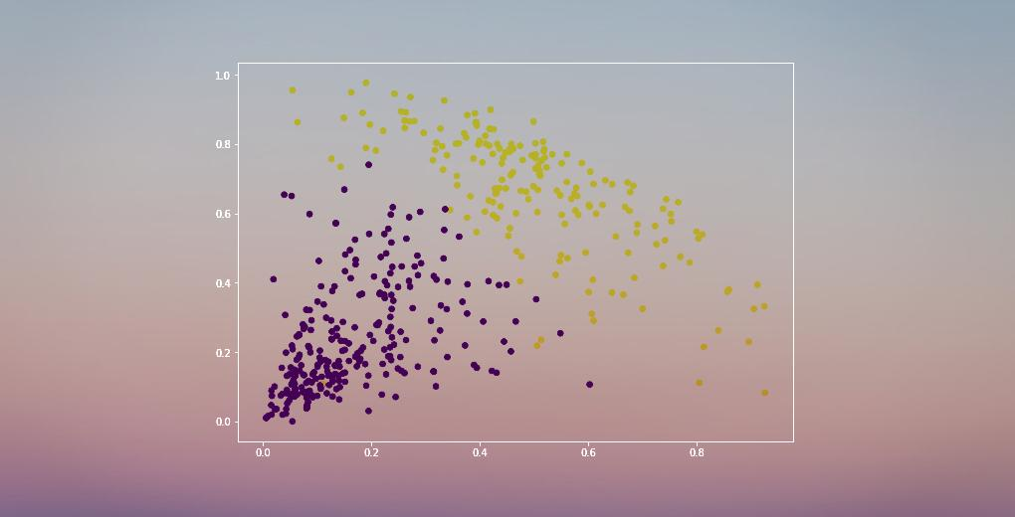
Discretization Techniques :
3. Discretization by Cluster
Clustering can be used to generate a concept hierarchy for A by following either a top-down splitting strategy where each initial cluster or partition may be further decomposed into several subclusters, forming a lower level of the hierarchy.
or a bottom-up merging strategy, where each cluster forms a node of the concept hierarchy where clusters are formed by repeatedly grouping neighboring clusters in order to form higher-level concepts.

Slide 56
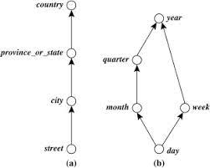
Concept Hierarchy
Recursively reduce the data by collecting and replacing low level concepts (such as numeric values for age) by higher level concepts (such as young, middle-aged, or senior)
Concept hierarchy for nominal data

Slide 57
Types of discretization
1 : Supervised discretization : Uses class information
2: Unsupervised discretization : Do not uses class information
3. Splitting (Top-down discretization) –Discretization process first finds few points called split points or cut points to split the entire attribute range.
4. Merging (Bottom-up discretization)-considers all values as split points and then merges neighborhood values to form intervals.

Slide 58
Data Reduction
Data reduction techniques obtain a reduced representation of the data while minimizing the loss of information content.
Data reduction strategies
Data cube aggregation: construction of data cubes.
Attribute subset selection-remove irrelevant attributes
Dimensionality reduction-reduce data set size using encoding
Numerosity reduction - smaller forms of data representation
Discretization and concept hierarchy generation - raw data replaced by higher conceptual levels

Slide 59
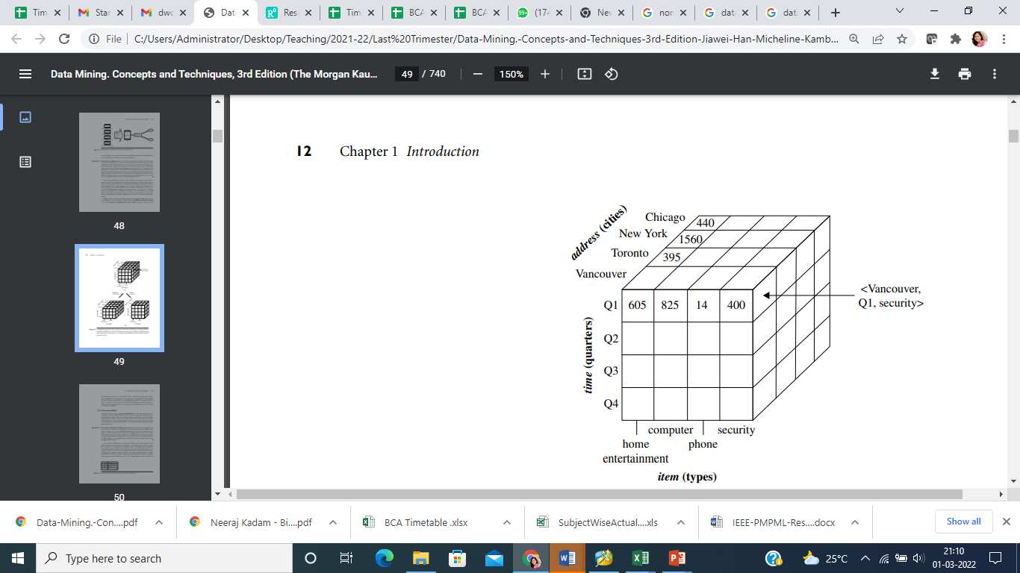

Slide 60
Attribute subset selection
Data may contain hundreds of attributes , all may not be relevant to mining task. Some are redundant
Domain knowledge can be used to decide attribute set
Leaving out relevant attributes as also keeping irrelevant attributes can affect mining quality
Volume of irrelevant or redundant attributes can slow down the mining process
Select a minimum set of features such that the probability distribution of different classes given the values for those features is as close as possible to the original distribution given the values of all features
It also reduces no of attributes in the discovered patterns which then are easier to understand

Slide 61
Techniques for Attribute subset selection
Step-wise forward selection –start with empty set or reduced set and add the best of the remaining
Step-wise backward elimination- start with the whole set of attributes and remove the worst attribute remaining in the set
Combining forward selection and backward elimination – select the best and remove the worst
Decision-tree induction-At each node , the algorithm chooses the best attribute to partition data into classes. A attribute that does not appear in the tree (not selected) is irrelevant

Slide 62
Decision tree example
Patient Id | Sore throat | Fever | Swollen Glands | Congestion | Headache | Diagnosis
1 | Yes | Yes | Yes | Yes | Yes | Strep throat
2 | No | No | No | Yes | Yes | Allergy
3 | Yes | Yes | No | Yes | No | Cold
4 | Yes | No | No | No | No | Strep throat
5 | No | Yes | No | Yes | No | Cold
6 | No | No | No | Yes | No | Allergy
7 | No | No | Yes | No | No | Strep throat
8 | Yes | No | No | Yes | Yes | Allergy
9 | No | Yes | No | Yes | Yes | Cold
10 | Yes | Yes | No | Yes | Yes | Cold

Slide 63
Swollen
Glands
No
Yes
Fever
Diagnosis=Strep Throat
No
Yes
The attributes Sore throat, congestion and headache do not play any role in determining a diagnosis
Diagnosis=Allergy
Diagnosis =Cold

Slide 64
Numerosity Reduction
The data volume can be reduced by choosing alternative, smaller forms of data representation
Parametric methods
Assume the data fits some model, estimate model parameters, store only the parameters, and discard the data (except possible outliers)
Linear regression: Data are modeled to fit a straight line Often uses the least-square method to fit the line. The regression coefficients can be used to represent data
Multiple regression: allows a response variable Y to be modeled as a linear function of multidimensional feature vector.
Non Parametric methods
Histograms :It partitions data distribution of attribute into disjoint subsets or buckets and store average (sum) for each bucket.
Clustering- Partition data set into clusters based on similarity, and store cluster representation (e.g., centroid and diameter) only

Slide 65
Revision questions
Explain the need of data cleaning in data mining process
What is data cleaning? State and explain any four techniques of cleaning data
State and explain the measures of dispersion of data
What do you mean by data cleaning. Discuss the ways to deal with missing values and to remove the noise from the data set
state and explain Measures of central tendency
Find mean median, mode , interquartile range for the given data
What is data reduction. State and explain any four methods of data reduction
What is data normalization State and explain any four methods of data reduction
What do you mean by data transformation ? State and explain any five data transformation techniques
Discuss data discretization. Explain any three ways to achieve data discretization
What do you mean by attribute selection ? Discuss four techniques of attribute selection
Define Numerosity Reduction. Discuss parametric and nonparametric methods of numerosity reduction
Explain histogram and boxplot for graphical representation of the data

